Slide 1


By : Harsh Saini

Slide 2


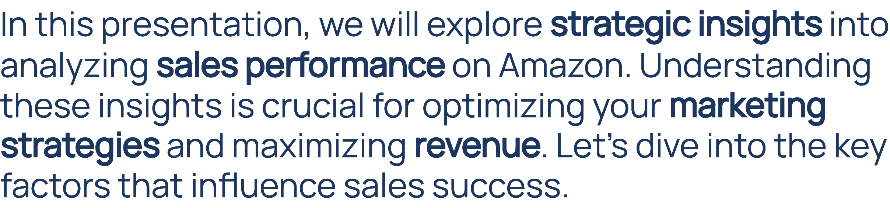

Slide 3

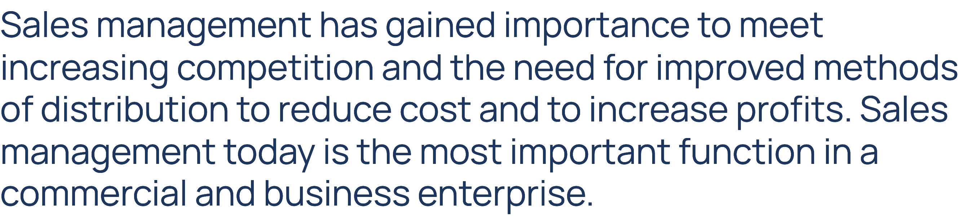


Slide 4


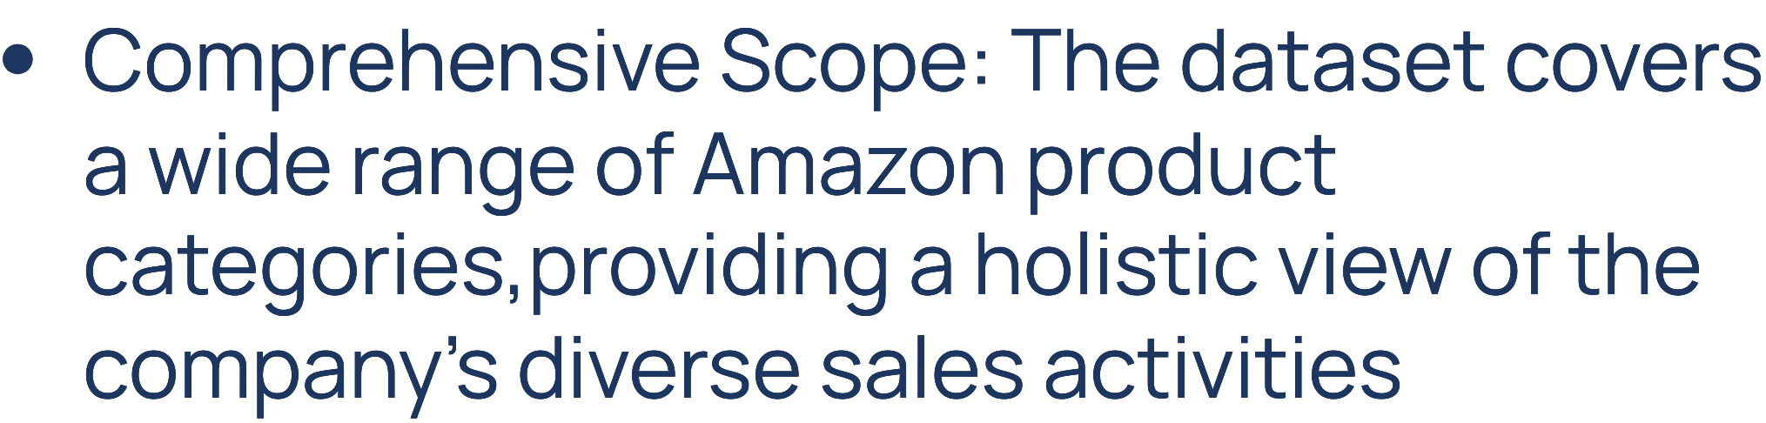

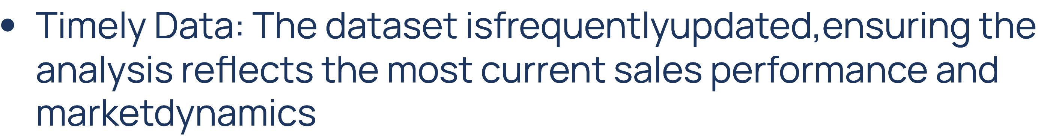
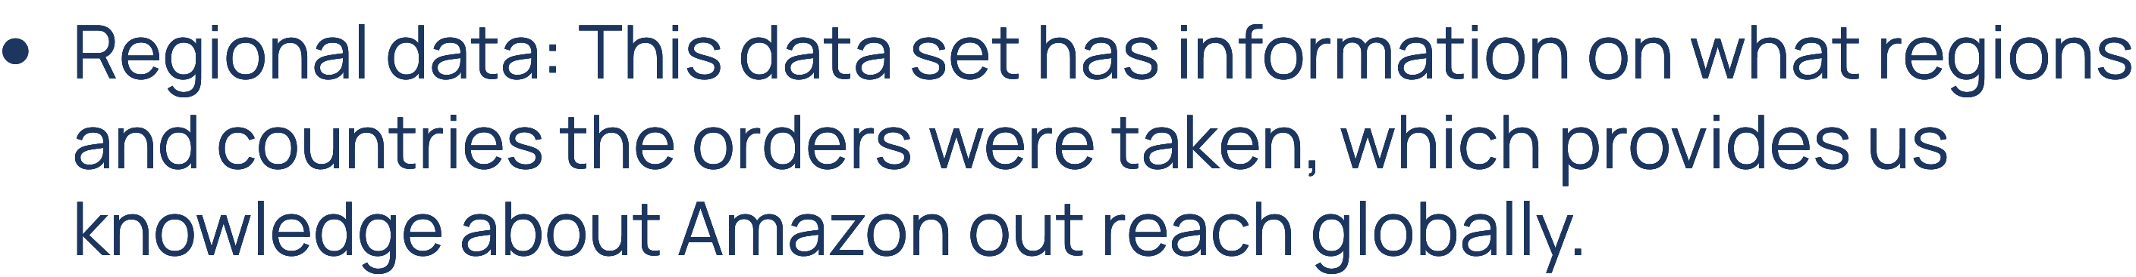

Slide 5



Slide 6
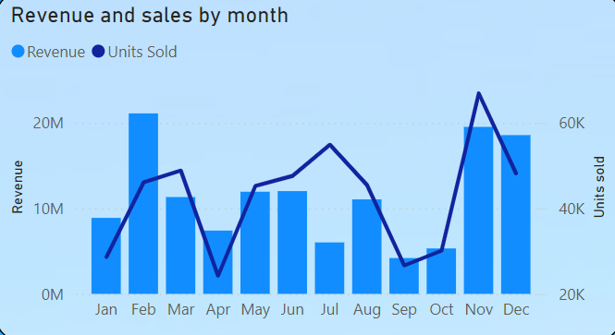
1. February Peak in Revenue:
February has the highest revenue, reaching approximately 20 million. Despite this, the number of units sold in February is relatively low compared to other months, suggesting higher revenue per unit or the sale of premium products.
2. Sales Dip in March:
There is a noticeable drop in both revenue and units sold in March.
3.Strong Performance in Q4:
The fourth quarter, particularly in October and November, shows a significant increase in units sold, especially in November.

Slide 7
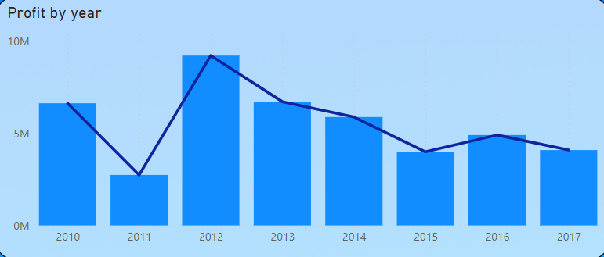
1. 2012 Peak in Profit:
The highest profit was in the year 2012 which is near about 10 million. That indicates whichever strategies or market conditions that were put in place during 2012 worked well.
2. Significant Drop in 2011:
Profit has gone down in 2011 versus previous year, as it is very visible. This might suggest that the year itself was tough.
3. Declining Trend After 2012:
Profits have dropped steadily since 2012 after a record year. This suggests that competition is increasing or the market saturating.
4. Stabilization in 2016 and 2017:
In 2016 and 2017, the profit levels off and remains relatively stable, though at a lower level compared to earlier years. This could suggest that the company has adapted to the market changes and stabilized its operations.

Slide 8
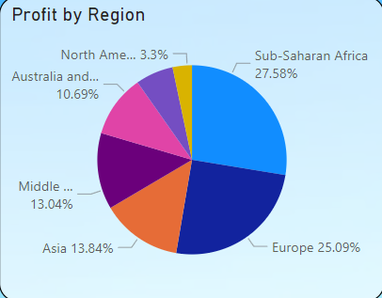
1. The Leading Sub-Saharan Africa:
The largest share of the profit comes from Sub-Saharan Africa: 27.58%. This shows that this area is where the business makes most of its sales.
2.Europe Profit Contribution Strong:
Europe, is the second highest profit making region after Sub-Saharan Africa with 25.09% of total Profit being input from here 🌎 Europe along with Sub-Saharan Africa accounts for over half of the total profit, which shows its main significance.
3.Roughly in the middle of that list were Asia and Middle East:
Asia and the Middle East represent 13.84% and 13.04%, respectively, in terms of profit. Although not the biggest contributors, these areas still represent sizeable markets and an opportunity for expansion.

Slide 9
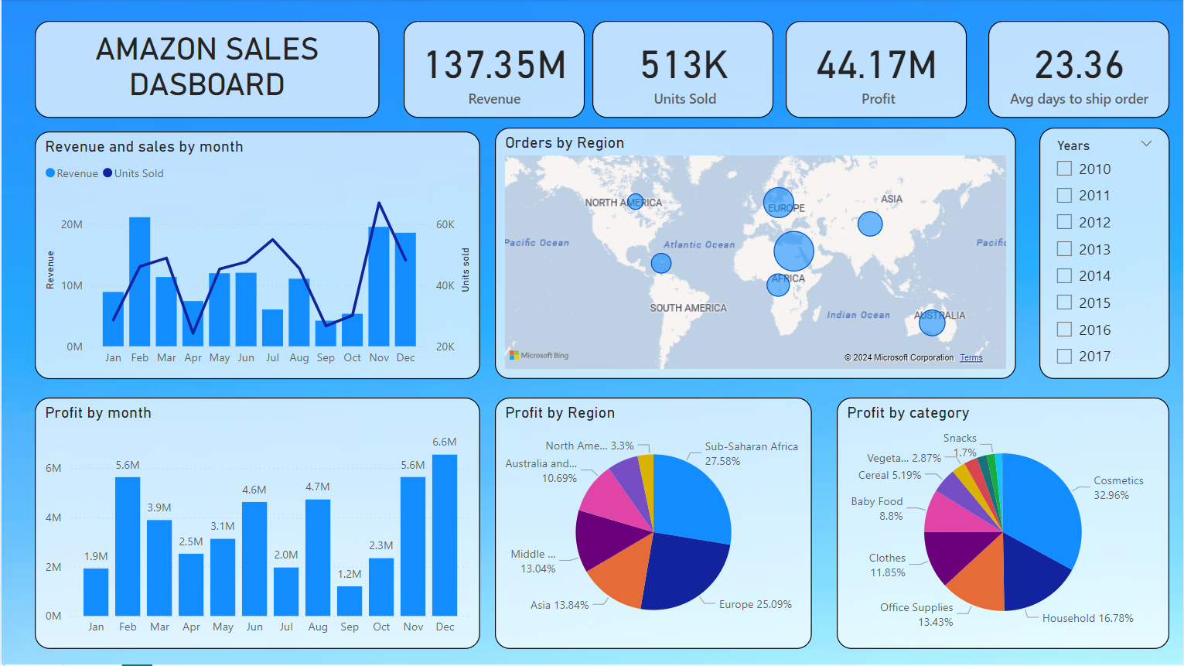

Slide 10
Insights & Analysis
February shows the highest revenue, but units sold don’t correspond as closely, suggesting higher-value sales during this month.
Europe and Africa dominate the order volumes, indicating strong market presence in these regions.
With 137.35M in revenue from 513K units sold, the average revenue per unit is approximately $267.
Sub-Saharan Africa and Europe combined contribute over 50% of the total profit, making them critical markets for profitability.
December is the most profitable month, peaking at 6.6M, likely due to holiday season sales.
Cosmetics lead in profitability at 32.96%, far outpacing other categories, emphasizing the importance of this product line.
The average of 23.36 days to ship an order suggests potential delays, highlighting an area for operational improvement.
Profit shows seasonal spikes in February and December, suggesting cyclical demand patterns.

Slide 11
RECOMMENDATIONS
Optimize Shipping Times:
With an average of 23.36 days to ship an order, reducing shipping times through logistics improvements or regional warehouses could significantly enhance customer satisfaction and boost repeat purchases.
Leverage Seasonal Trends:
Since profits peak in February and December, intensify marketing and inventory efforts before these months to maximize sales. Introducing seasonal promotions or new product launches could capitalize on the increased consumer spending.
Improve Supply Chain for Faster Delivery:
To reduce the long average shipping time, invest in technology and partnerships that can streamline supply chain processes, enabling quicker order fulfillment.
Capitalize on High-Profit Regions:
Focus on strengthening operations and expanding offerings in Sub-Saharan Africa and Europe, as these regions are already leading in profit contribution. Tailoring products and promotions to regional preferences could drive further growth.

Slide 12
Conclusion
This clearly shows that regional and seasonal factors disproportionately impact the sales. Sub-Saharan Africa, as well as Europe, makes the most profit, while product categories like cosmetics and items related to household aspects dominate in terms of money generation. This, therefore, directly implies that strategic planning in peak months, February and December, would go a long way to ensure that these periods assure maximum profitability. Such insights will guide future decisions on how better to optimize strategies in sales and overall performance.

Slide 13

DO YOU HAVE ANY QUESTIONS?
harshsaini1324@gmail.com

